Slide 1
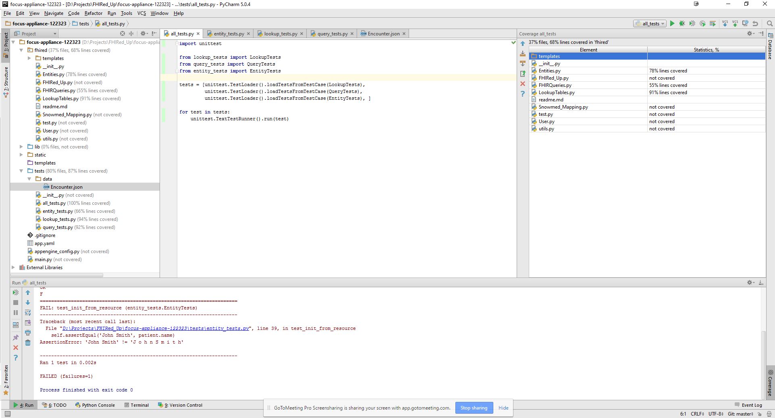

QA Testing
Notes:
Python’s unittest module was used to automate testing. Test suites have been developed for all of RADVs main modules. The test cases currently cover 68% of lines of code. We anticipate code coverage of approximately 85% in the final version of the tool.

Slide 2
Concerns & Other Issues
Application speed
Persistent data
Connecting the frontend web application to the backend database tier
Notes:
The RADV application makes many calls to the FHIR server. We are exploring ways to use caching to reduce this network traffic. We are also implementing a Google DataStore, which will allow us to store lookup tables and other persistent data. Finally, we are in the process of connecting the charts in the web application to live data from the database system.

Slide 3
Beta Version of the RADV Tool
https://focus-appliance-122323.appspot.com/login
Login: FHIRedUp
Password: PjV7kGTD
Notes:
This final slide shows the web address of the RADV tool. You can use this username and password to view the beta version of the software.

